Slide 1

Merger with MAGIST?
ENIAC. More Than Just a Marketplace

Slide 2


Brazil in a Snapshot
28.51%
9.22%
Brazil’s share of the Latin American market
E-commerce as a percentage of total retail sales in Brazil
Top Brazilian e-commerce sites
Mercado Livre
Amazon
Shoppe
Brazil represents the most developed e-commerce market in Latin America.
Notes:
❓ Is Brazil's online tech market growing?
❓ How does Magist’s delivery network perform?
❓ Can Magist help us compete with local players?

Slide 3
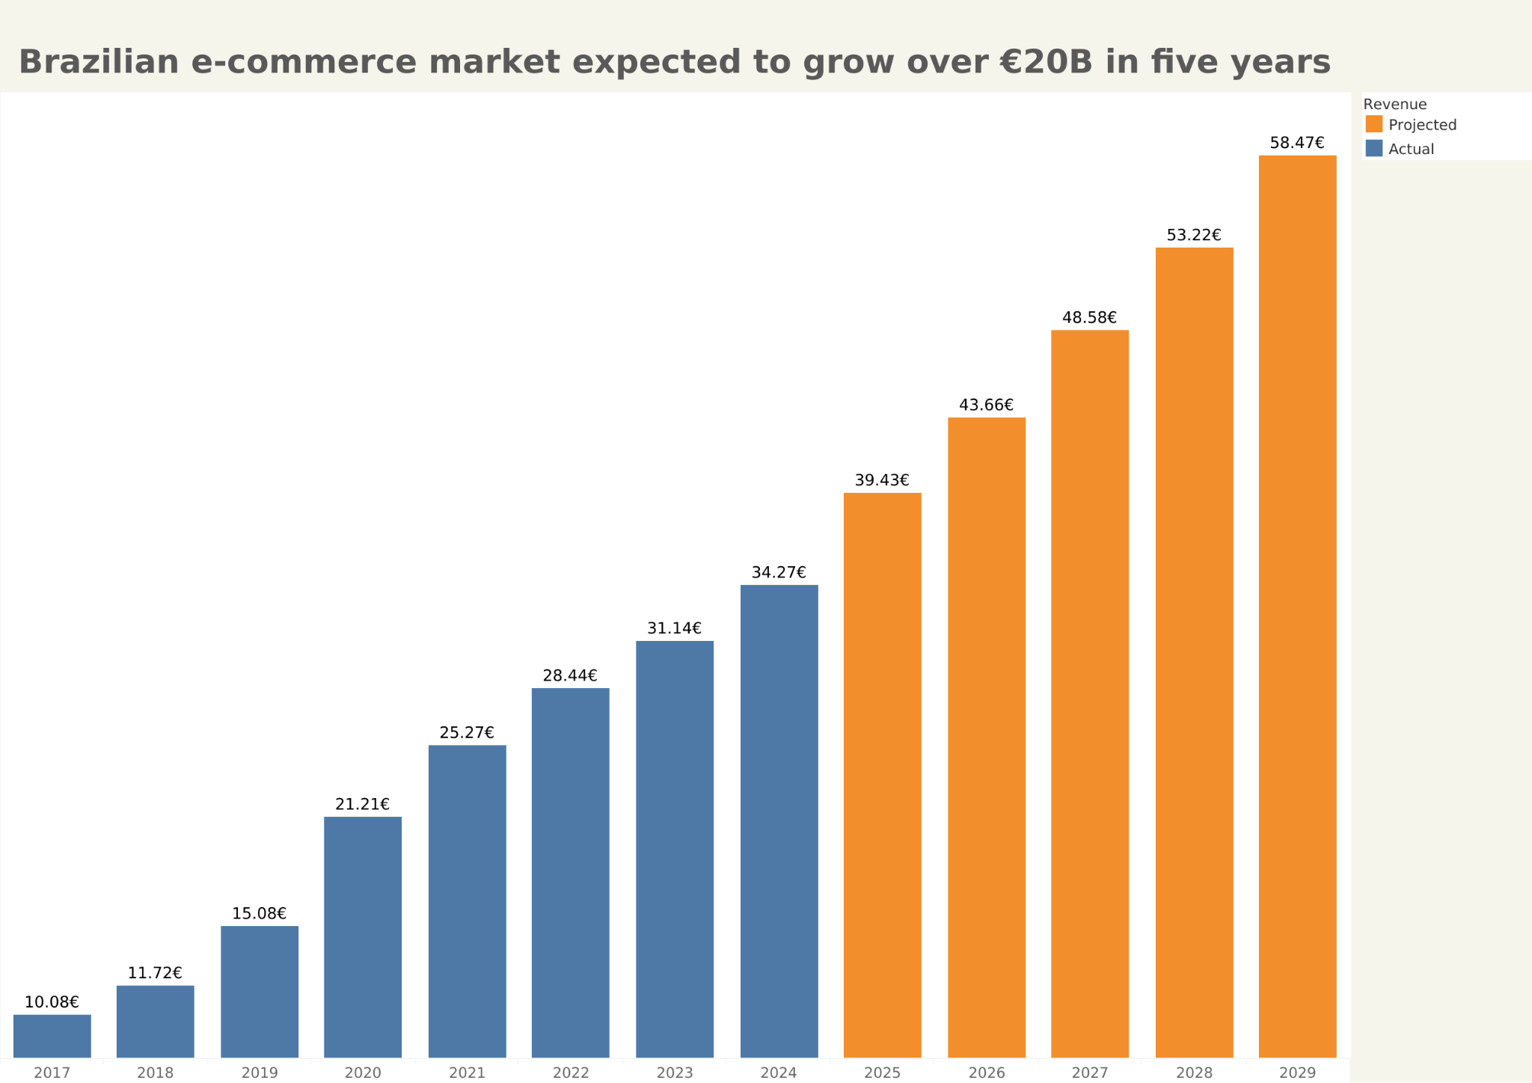
Source: ABCOMM Associação Brasileira de Comércio Eletrônico

Slide 4
Revenue & Pricing –
Are We a Good Match?

Slide 5
Financials
Revenue in 2017
Average Monthly Revenue (Tech)
Average Tech Item Price
ENIAC
€ 14M
€ 1.17 M
€ 540
magist
€ 9.6 M
€ 147
€ 127
Notes:
the average monthly income of Tech sellers
Can a budget-focused marketplace serve a premium tech brand?

Slide 6
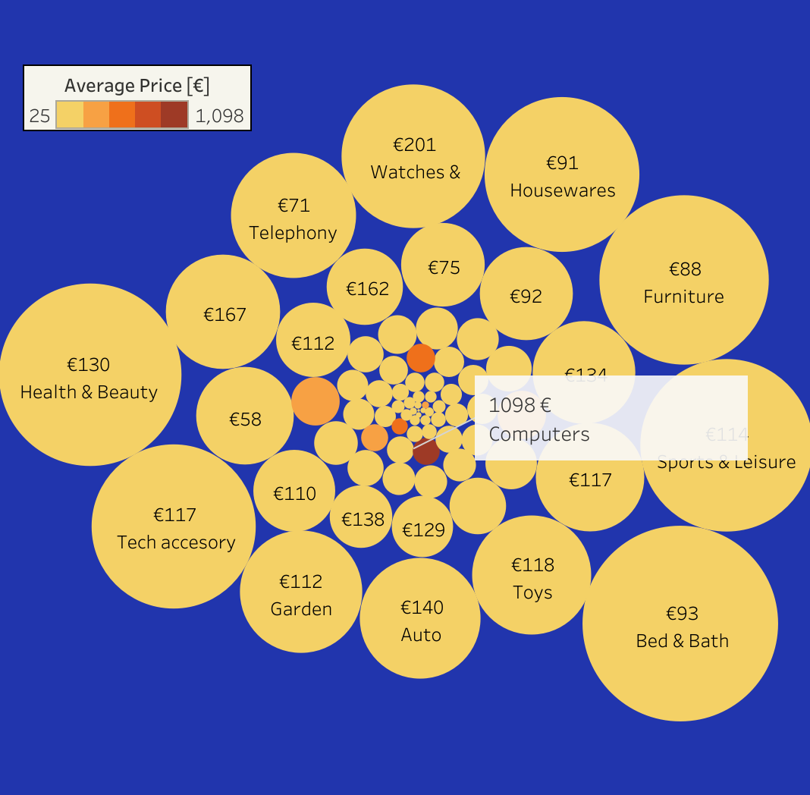
What’s Selling on Magist?
Notes:
Categories above 3000 order count
Product categories offered by magist

Slide 7
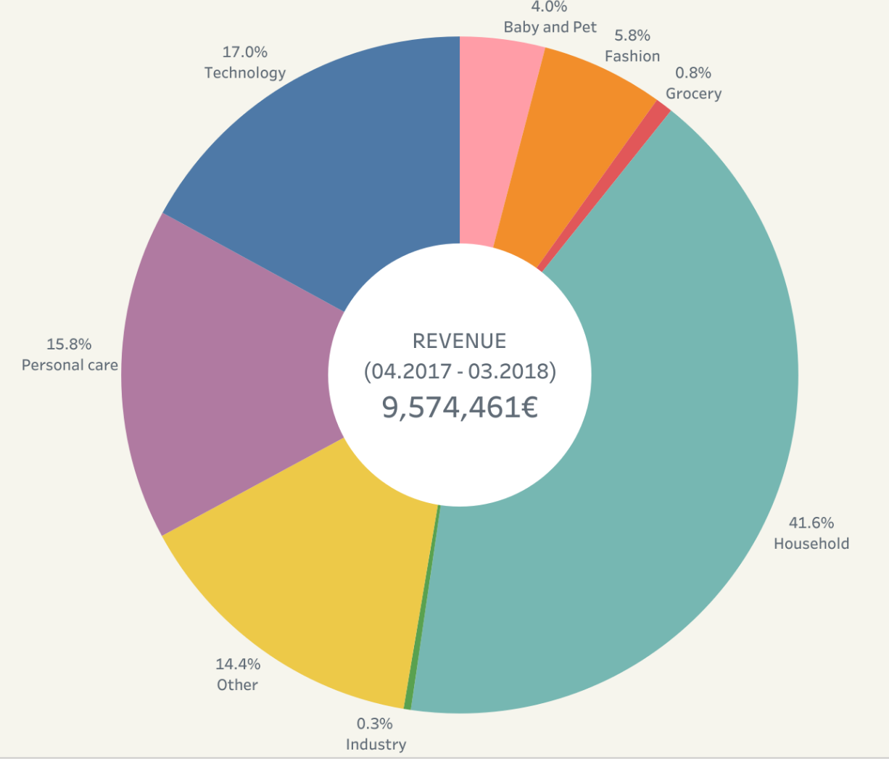
Magist’s Products and Reach
Notes:
Categories above 3000 order count
Product categories offered by magist

Slide 8
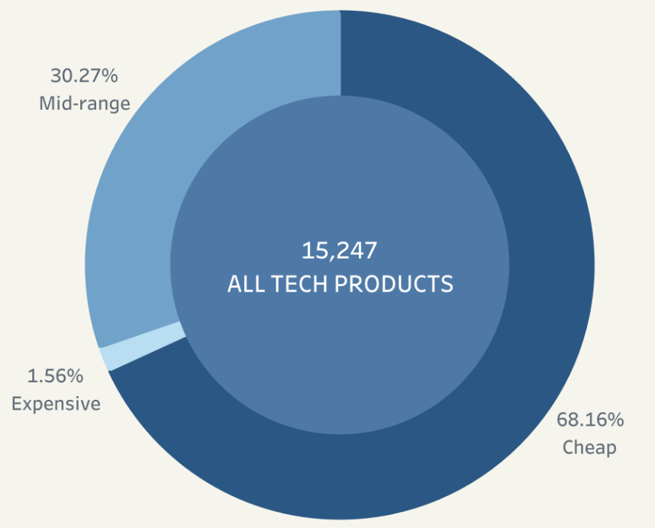
Low-Cost Gadgets or High-End Tech?
📉 High-end tech sales do not dominate Magist’s marketplace.
Notes:
Low-Cost Gadgets or High-End Tech? Where Does Magist Stand?
💡 Key Points:
❌ Majority of Magist’s sales are not high-end tech.
❌ Most sold categories include household appliances, budget electronics, and accessories.
⚠️ Less focus on premium, Apple-compatible accessories.

Slide 9
Magist’s Sellers: Small Businesses or Serious Tech Players?

Slide 10
Tech sellers make up 14.67% of all sellers in Magist.

Slide 11
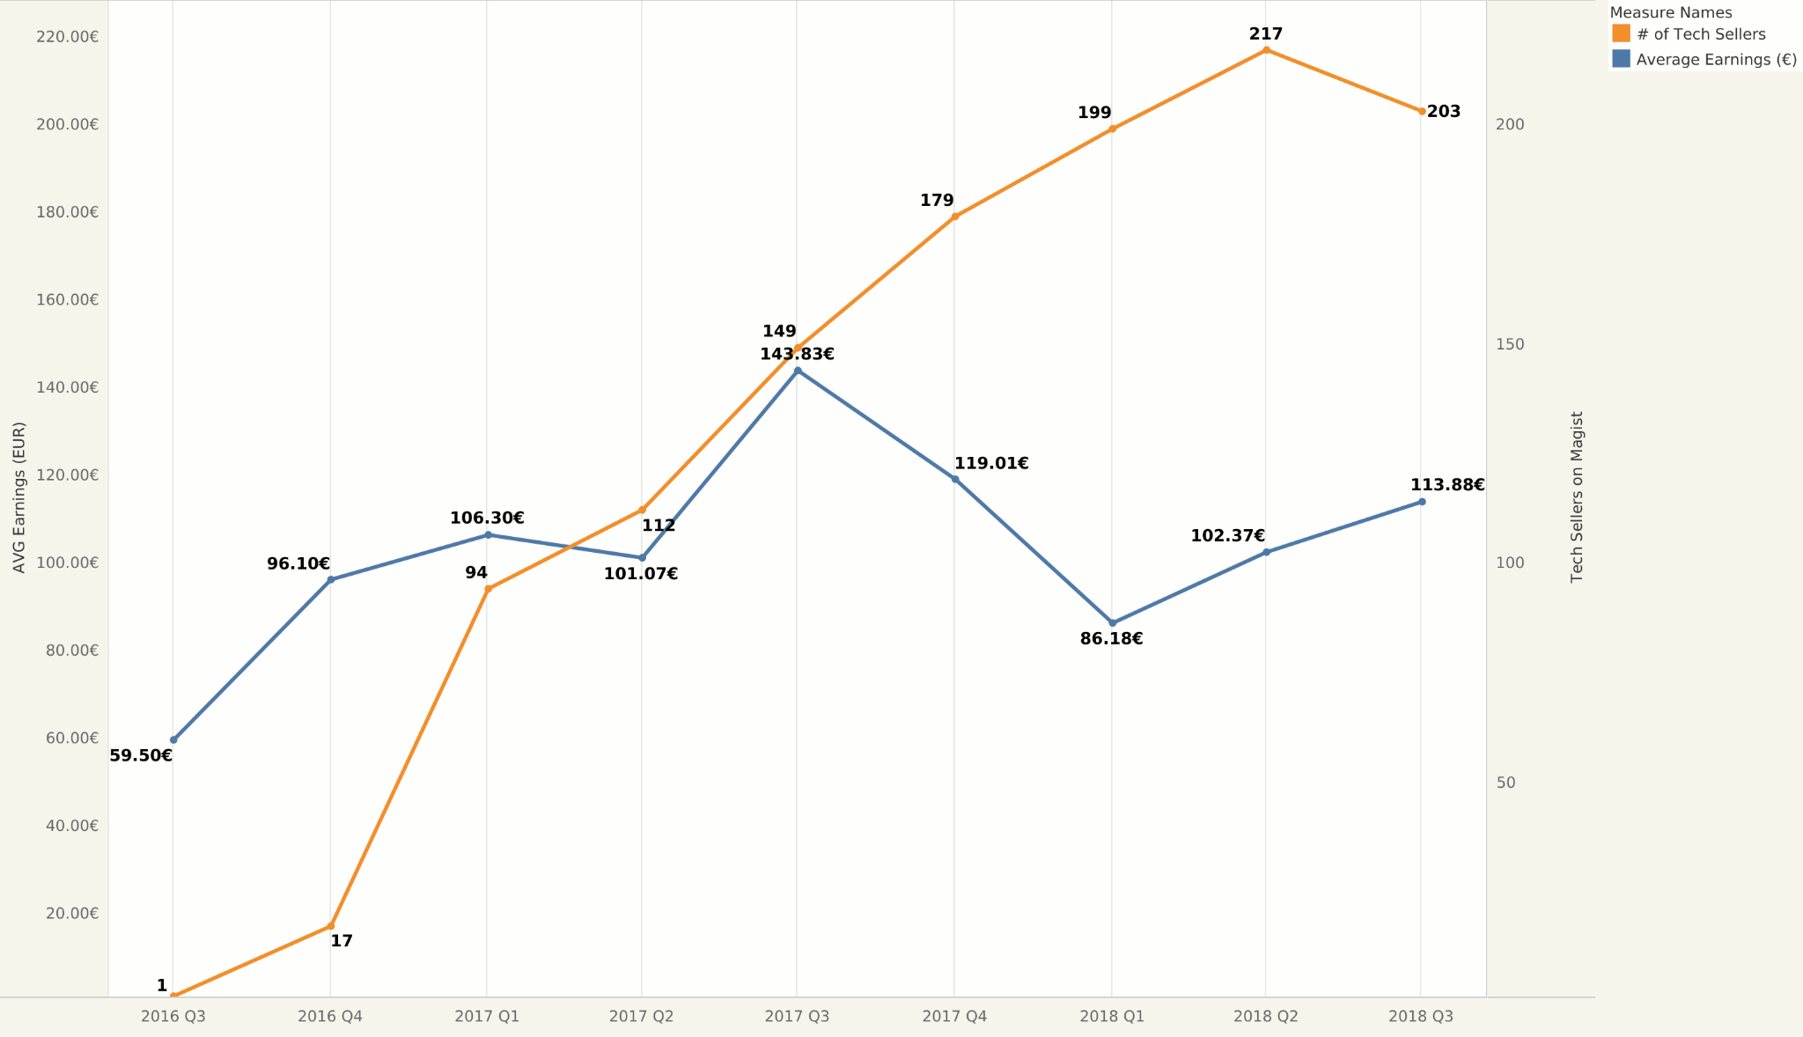
Tech sellers struggle to earn over 150€ quarterly
Notes:
Seller Performance – Can Individual Sellers Scale?

Slide 12
Fast Enough for Eniac?
Magist’s Delivery Speeds Under the Microscope

Slide 13
On average, deliveries arrive within 12.5 days of purchase.

Slide 14
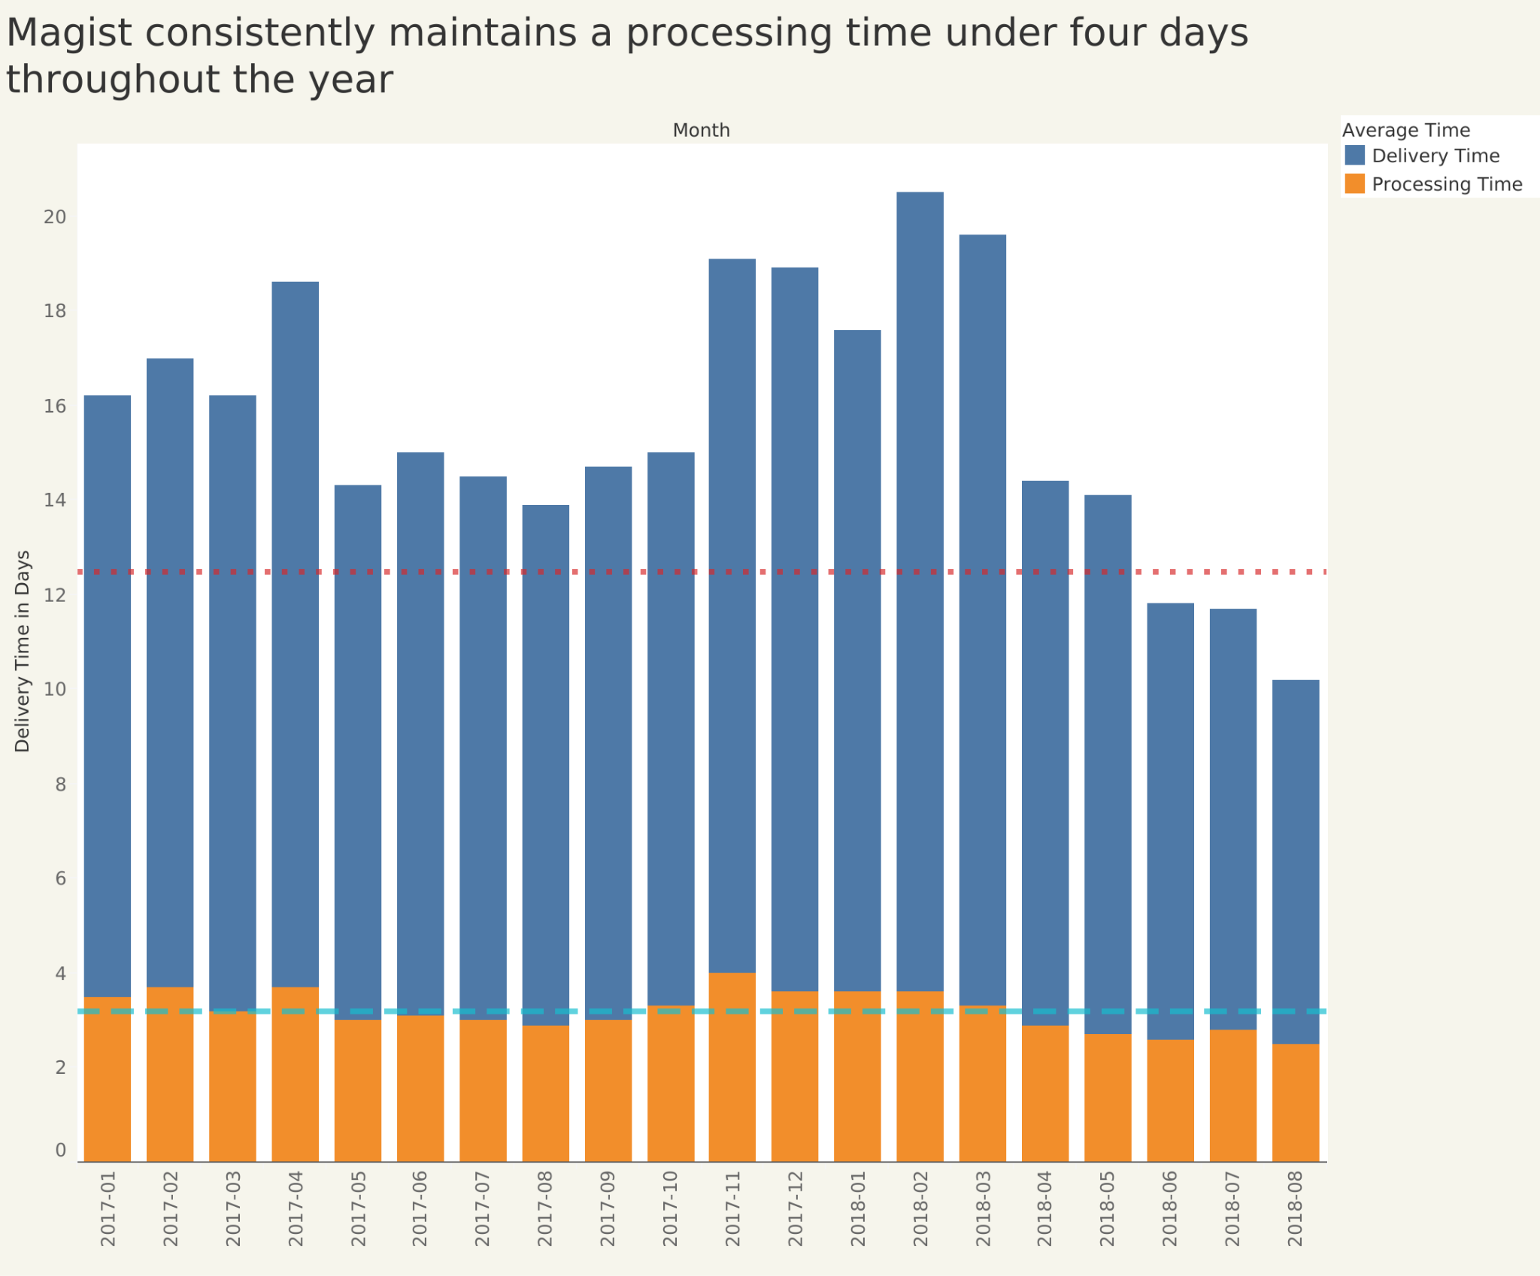

Slide 15
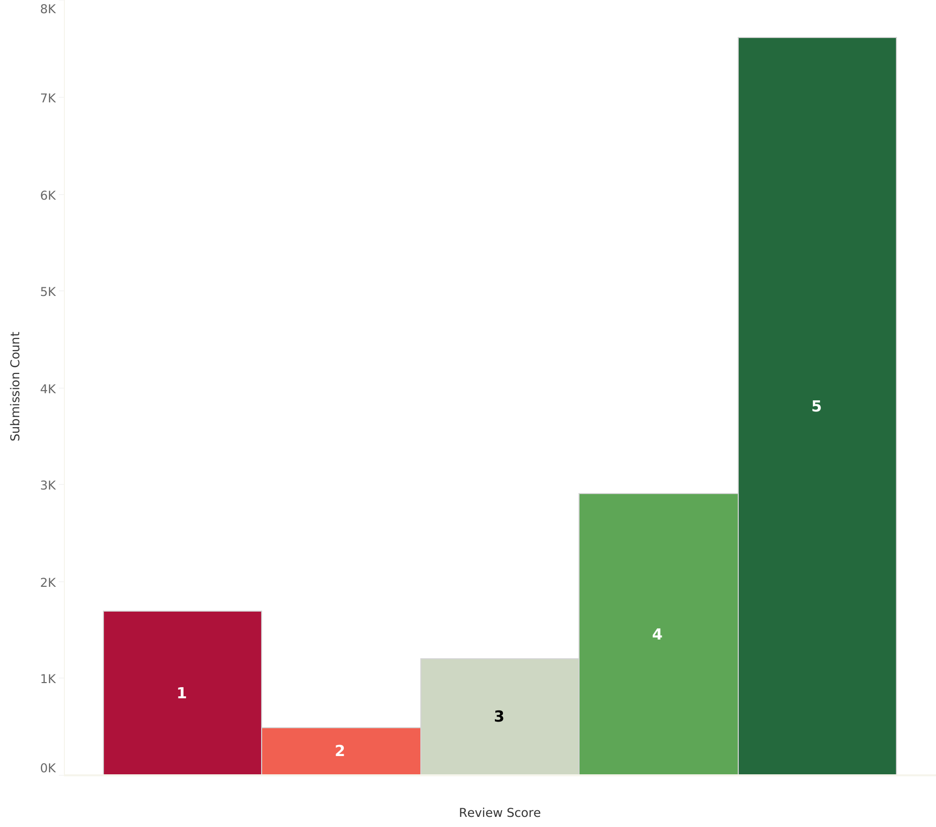
Over 75% of customer reviews are above average
Notes:
Low-Cost Gadgets or High-End Tech? Where Does Magist Stand?

Slide 16
Pros & Cons – The Verdict So Far

Slide 17

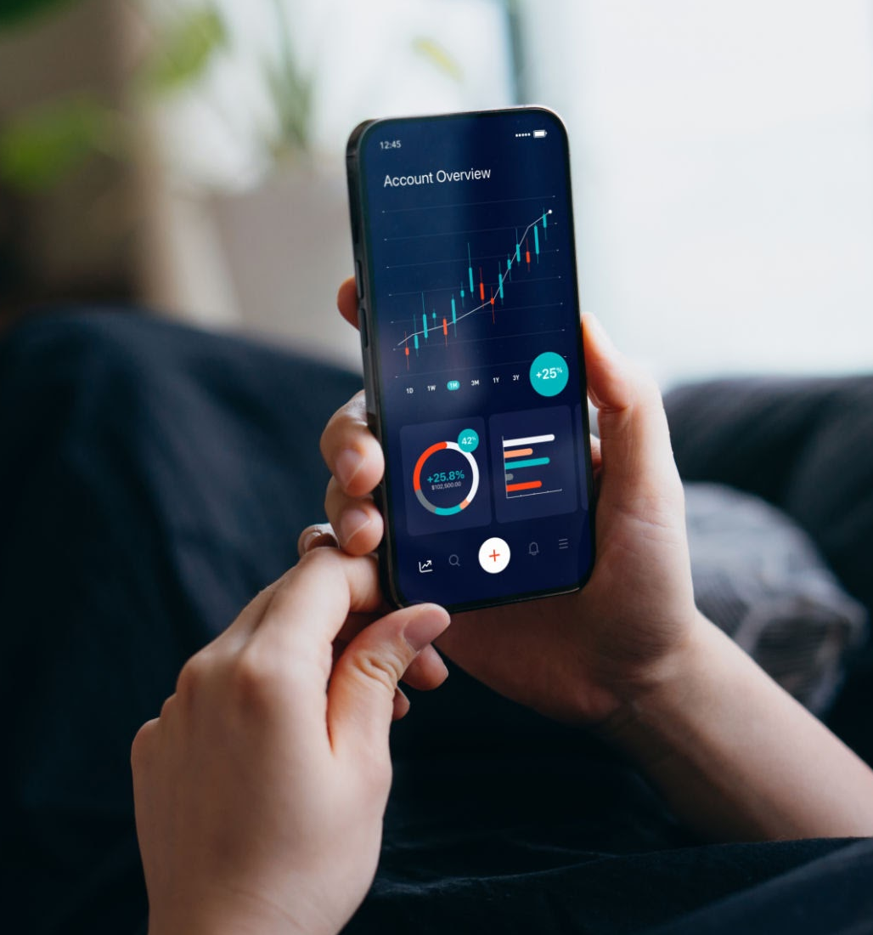
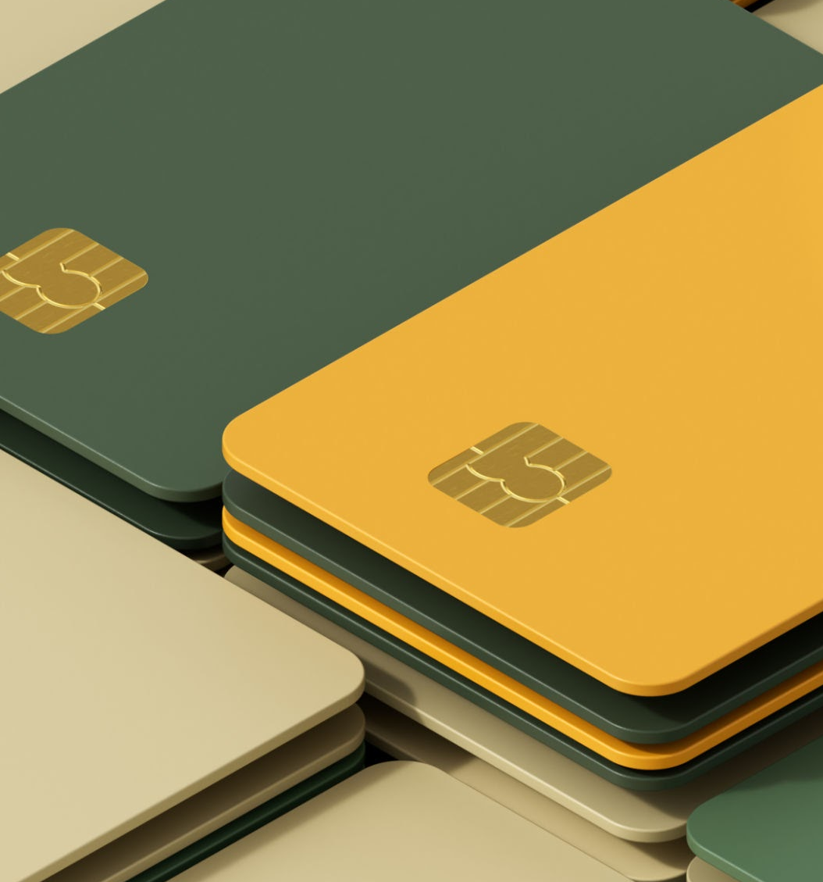
Pros & Cons
✅ Pros:
Large Brazilian e-commerce footprint.
Established logistics network.
Access to an existing tech customer base.
Customer satisfaction.
❌ Cons:
Focused on low-cost products, not premium Apple accessories.
Delivery times are not optimized for fast tech support.

Slide 18
Appendix
https://dados.abcomm.org/crescimento-do-ecommerce-brasileiro
https://americasmi.com/insights/online-customer-journey-brazil-logistics-impact/?utm_source=chatgpt.com
https://americasmi.com/insights/report-last-mile-logistics-latin-america/
https://gs.statcounter.com/os-market-share/mobile/brazil/#monthly-201801-202410
https://www.statista.com/statistics/1117196/delivery-time-e-commerce-brazil/

